Slide 1
System Approach

Slide 2
System
A system is a set of interrelated but separate parts working towards a common purpose.
The arrangement must be orderly and
there must be proper communication facilitating interaction between the elements and
finally this interaction should lead to achieve a common goal.

Slide 3
System Approach
System approach is to view the organization as a unified, purposeful system composed of interrelated parts.
This approach also gives the manager to see the organization as a whole and as a part of the larger external environment.
System oriented manager would make decisions only after they have identified impact of these decisions on all other departments and the entire organization.
They must link the departments within the organization and communicate with all other departments, employees and with each other.

Slide 4
One its most important characteristic is that it is composed of hierarchy of sub-systems.
That is the parts forming the major system and so on.
For example, the world can be considered-to be a system in which various national economies are sub-systems.
In turn, each national economy is composed of its various industries, each industry is composed of firms and of course a firm can be considered a system composed of sub-systems such as production, marketing, finance, accounting and so on.

Slide 5
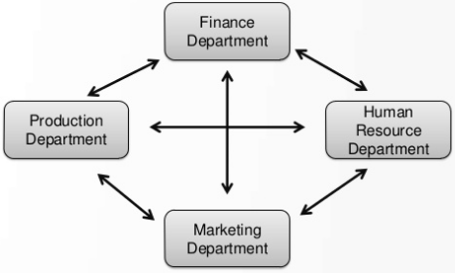
Example

Slide 6
Features of System Approach
A system consists of interacting elements. It is set of inter-related and inter-dependent parts arranged in a manner that produces a unified whole.
The various sub-systems should be studied in their inter-relationships rather, than system has a boundary that determines which parts are internal and which are external.
A system does not exist in a vacuum. It receives information, material and energy from other systems as inputs. These inputs undergo a transformation process within a system and leave the system as output to other systems.
An organization is a dynamic system as it is responsive to its environment. It is susceptible to change in its environment.

Slide 7
Advantages of System Approach
It aims at meaningful analysis of organizations and their management.
It facilitates the interaction between organization and its environment.
It guides the managers to avoid analyzing problems in isolation and to develop an integrated approach.

Slide 8
Conclusion
The systems approach assists in studying the functions of complex organizations and has been utilized as the base for the new kinds of organizations (e.g. project management)
It is possible to bring out the inter-relations in various functions like planning, organizing, directing and controlling.
This approach has an edge over the other approaches because it is very close to reality.
It cannot be easily applied to large and complex organizations. Moreover, it does not provide any tool and technique for managers.

